Slide 1
MALIGNANT COMMENTS CLASSIFICATION
Submitted by:
Harneet Kaur rehsi

Slide 2
ACKNOWLEDGMENT
I want to thank my SME Khusboo Garg and Flip Robo Techniques to express our sincere thanks to the following people, without whom we would not have been able to complete this project

Slide 3
INTRODUCTION
Business Problem Framing: The proliferation of social media enables people to express their opinions widely online. However, at the same time, this has resulted in the emergence of conflict and hate, making online environments uninviting for users. Although researchers have found that hate is a problem across multiple platforms, there is a lack of models for online hate detection. . This can take a toll on anyone and affect them mentally leading to depression, mental illness, self-hatred, and suicidal thoughts.
Review of Literature: In this project, Our goal is to build a prototype of online hate and abuse comment classifier which can be used to classify hate and offensive comments so that they can be controlled and restricted from spreading hatred and cyberbullying. These are some columns in our data ‘Id’, ‘Comments’, ‘Malignant’, ‘Highly malignant’, ‘Rude’, ‘Threat’, ‘Abuse’, and ‘Loathe’.
Motivation for the Problem Undertaken: There has been a remarkable increase in the cases of cyberbullying and trolls on various social media platforms. Many celebrities and influences are facing backlash from people and have to come across hateful and offensive comments. This can take a toll on anyone and affect them mentally leading to depression, mental illness, self-hatred, and suicidal thoughts.

Slide 4
Analytical Problem Framing
Mathematical/ Analytical Modeling of the Problem:
Data contains 159571 rows and 8 columns. columns contain object datatype and int datatype as well. With the help of value_count, we have seen the value each column contains. Then used describe the method to check the health of the dataset. IsNull for checking if data contain some Nan values. used some EDA methods for a better understanding of the data. Then check the skewness of the data. with the help of replace method, I have replaced some data containing addresses, email, etc with meaningful data. And replaced numbers with numbers. Store all the targets in one single column. Convert text into vectors then split the data using train test split and used 4 different classification models.
Data Preprocessing Done:
As data contain some object type data with the help of replace method, I have replaced some data containing addresses, email, etc with meaningful data. And replaced numbers with numbers. Store all the targets in one single column. Convert text into vectors and used all these methods for better model prediction.

Slide 5
Data Sources and their formats: Data contains 159571 rows and 8 columns respectively. containing all the necessary details.
State the set of assumptions (if any) related to the problem under consideration: In this data set we have taken assumption as . In every columns : 0 = NO , 1 = YES

Slide 6
Visualizations

Slide 7
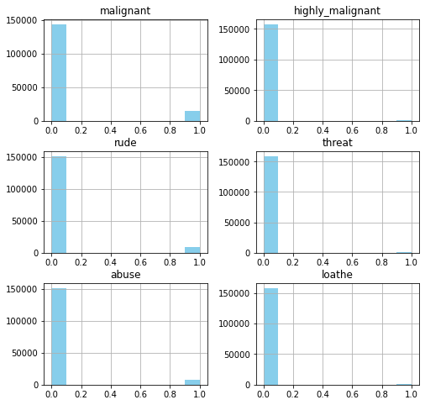
Applied Histogram on the dataset

Slide 8
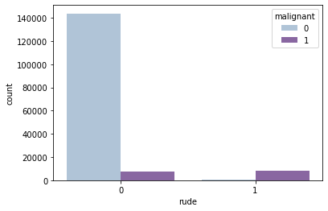
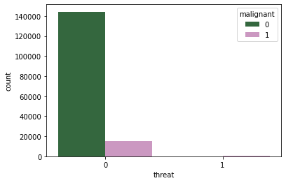
Used Countplot for checking Malignant and rude column dataset
Used Countplot for checking Malignant and threat column dataset

Slide 9
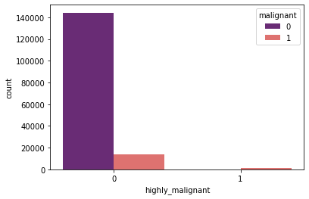
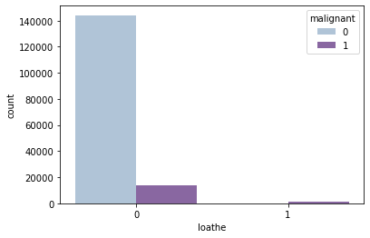
Used Countplot for checking Malignant and highly malignant column dataset
Used Countplot for checking Malignant and loathe column dataset

Slide 10
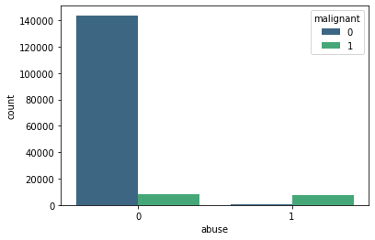
Used Countplot for checking Malignant and abuse column dataset

Slide 11
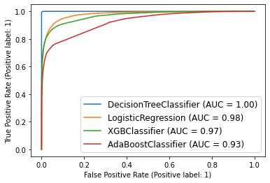
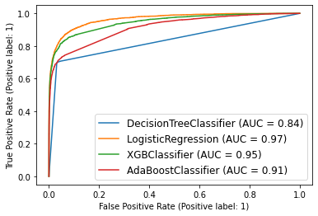
Logistic Regression fits best among all other models Logistic Regression is given: 0.97 score while testing 0.98 score while training
Checking the score of different models on testing data that which model fit best
Checking the score of different models on training data that which model fit best

Slide 12
CONCLUSION
Key Findings and Conclusions of the Study :
A value of 0 as No is more than values of 1 as Yes in these columns. The majority of these texts 0 that is are Not malignant. Logistic Regression fits best among all other models As Logistic Regression is given:
0.97 score while testing 0.98 score while training
Learning Outcomes of the Study in respect of Data Science:
As data contain some object type data with the help of replace method, I have replaced some data containing addresses, email, etc with meaningful data. And replaced numbers with numbers. Store all the targets in o are ne single column. Convert text into vectors and used all these methods for better model prediction. As the value of 0 as No is then the value of 1 is Yes in these columns. Majority of these texts 0 that is ar Not malignant. Logistic Regression fits best among all other models As Logistic Regression is given:
0.97 score while testing 0.98 scores while training

